Slide 1
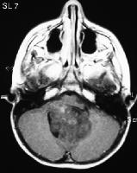
DIAGNOSIS AND MANAGEMENT OF MIDLINE POSTERIOR FOSSA TUMORS IN CHILDREN

Slide 2
INTRODUCTION
Medulloblastoma
Ependymoma
Astrocytoma
Brainstem glioma
Choroid plexus papilloma
Dermoid

Slide 3
Medulloblastoma
Bailey and Cushing in 1925 first used the
term medulloblastoma.
One of the most common tumors of posterior fossa
(20 – 25 % all pediatric brain tumors)
5 –7 yrs – median age of diagnosis.
2 – 4 and 6 –8 yrs : two peaks in children

Slide 4
Medulloblastoma
  Histologic subtypes:
  Classical medulloblatoma
  Desmoplastic medulloblastoma
  Medullomyoblastoma
  Melanotic medulloblastoma
  Large-cell medulloblastoma: Very poor outcome

Slide 5
Medulloblastoma….origin
Debatable:
  Origin from remnant of cells of the external
  granular layer of the cerebellum.
  Transformation of normal undifferentiated
  progenitor cells of superior medullary velum
  which migrate to the external granular layer.

Slide 6
Medulloblastoma….Clinical
Hydrocephalus : Raised ICP
    Behavioral change, listlessness, irritability, vomiting, and
    decreased social interactions.
    Headache, especially in the morning.
    Double vision.
    Head tilt : tonsillar herniation below the foramen magnum.
    (Can result from trochlear nerve palsy caused by direct tumor compression )

Slide 7
Medulloblastoma….Clinical
Cerebellar symptoms
Brain stem involvement
Leptomeningeal dissemination

Slide 8
Medulloblastoma….Clinical
Physical:
  Increasing head circumference , full anterior fontanalles with widely split cranial sutures.
Fundus examination
  Papilledema can be present in as many as 90% of patients.

Slide 9
Medulloblastoma….Clinical
Extraocular examination
    Diplopia and lateral gaze paresis
    Fourth cranial nerve palsy ( should be considered in any
    patient with a head tilt )
    Nystagmus
Cerebellar signs ( ataxia > unilateral dysmetria )

Slide 10
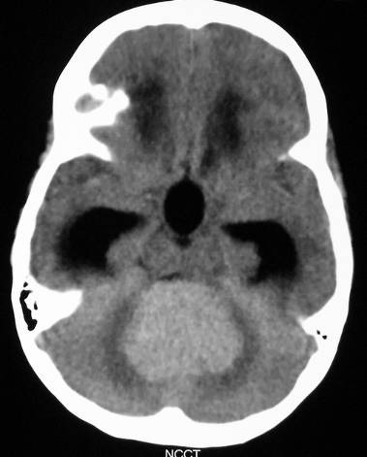
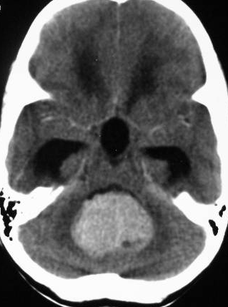
Radiology…….CT
NCCT
CECT

Slide 11
Radiology…….MRI
  Homogeneous enhancement ( may be absent in about
  15 – 20 % )
  DWI shows restricted diffusion with increased ADC.
  MRI spine : Should be done at time of diagnosis.
  BEST : prior to surgery. If not possible Should be
  delayed for at least 2 weeks after surgery.

Slide 12
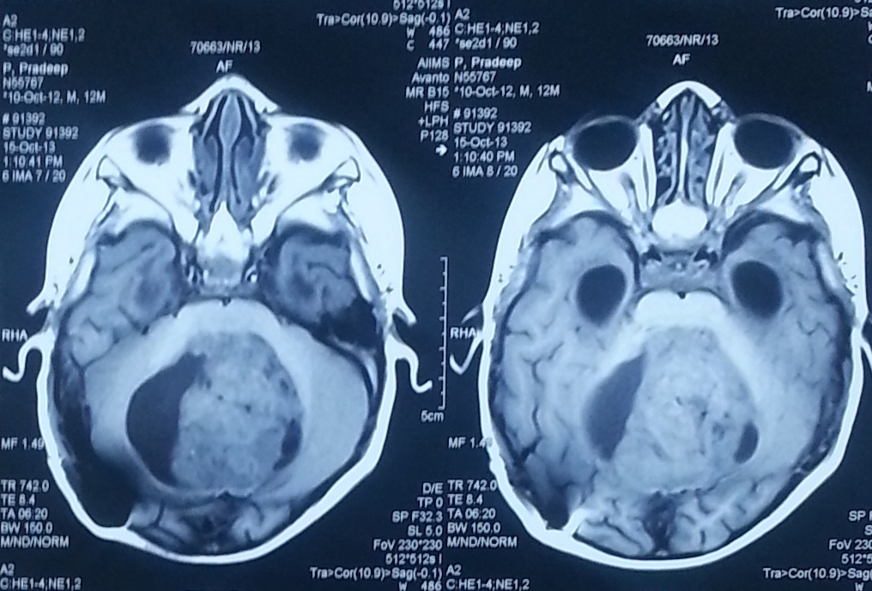
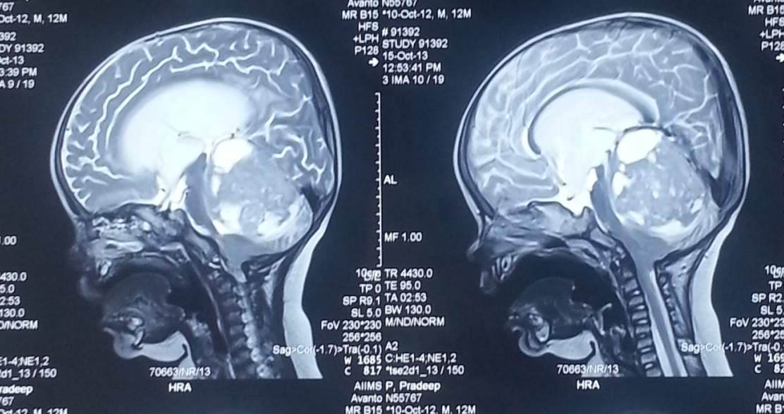
MEDULLOBLASTOMA

Slide 13
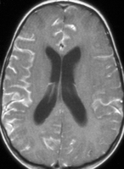
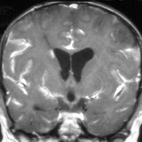
Leptomeningeal Dissemination

Slide 14
Radiology…….
Skeletal imaging
  Metastasis to the bone must be considered in any child with medulloblastoma and bone pain.
  A skeletal survey helps elucidate lytic or sclerotic lesions.

Slide 15
Diagnosis …..CSF cytology
No standardized method: HOW and WHEN ??
    Lumbar puncture
    Ventricular drain
    Cisterna magna at the time of surgery from the for cytologic analysis.

Slide 16
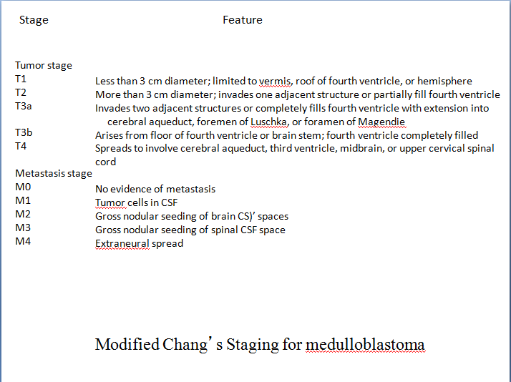

Slide 17
Staging……..
  Within 48 hours of surgery, a Gd MRI.
    Staging.
    Assess residual tumor size prior to the onset of
    enhancing reactive gliosis.
  Staging is dependent upon :
    extent of resection,
    radiographic evidence of tumor spread,
    and CSF cytology.

Slide 18
Current staging of medulloblastoma
Standard Risk
Posterior fossa
No metastasis
< 1.5 cm² residual
Undifferentiated
High Risk
Posterior fossa with
intracranial or spinal
dissemination.
Extra neural
metastasis
> 1.5 cm² residual
Differentiated

Slide 19
Diagnosis…..genetics
  Routine use : Controversial.
  Correlation between aneuploid DNA content and a
  better prognosis.
  17qi an isochromosome : Most common
  C-ERB2 – poor outcome
  Neurotropin growth factor receptor (TrkC)
  expression: associated with better outcome.

Slide 20
Risk factors associated with outcome for medulloblastoma
Good Prognosis
Females Sex
Gross total resection
No metastasis
Desmoplastic histology
Increased apoptosis index
Hyperdiploidy
High TRKC expression
Poor Prognosis
Younger age
Subtotal resection
Metastasis
Large-cell anaplastic histology
Elevated Ki-67/MIB index
Aneuploidy
Elevated ERB2 expression
Isolated 17p LOH
Elevated expression and
amplification of MYCC
Up regulation of PDGFR
Over expression of calbindin-
D28k
Fisher PG etal. Biologic Risk Stratification of Medulloblastoma: The Real Time Is Now. J Clin Oncol 2004;22; 971-74

Slide 21
Presenation : MRI Brain and spine
Surgical resection
Management of hydrocephalus
> 3 years
< 3 years
Standard risk
Poor risk
Chemotherapy (No standard regimen)
Craniospinal radiation
OR Reduced dose radiation with
CT on reasarch protocol
Craniospinal radiation + adjunct CT
( CCNU, cisplatin vincristine
or CT on research protocol
Follow OR
Delayed RT till 3 years old
Management algorithm for medulloblastoma

Slide 22
Hydrocephalus
The majority of children with posterior fossa
tumors have hydrocephalus at the time of
presentation.
There is no consensus regarding the
management of HC in these children

Slide 23
Hydrocephalus
Treatment options:
  Ventriculoperitoneal shunt
  Perioperative EVD
  Endoscopic third ventriculostomy
  Direct surgical resection

Slide 24
Hydrocephalus……….
Recent studies have shown that ultimately 17 to 40% of children
have uncontrolled hydrocephalus and require shunt placement
during the postoperative period; and that this predominantly
occurred within the 1st postoperative month.
An expectant policy in these subgroup who ultimately require a
shunt place them at risk of developing intracranial hypertension
,an increased rate of CSF leakage, and pseudomeningocele
formation, prolonged hospitalization.

Slide 25
Hydrocephalus …….…Factors predicting patients at risk of requiring placement of a shunt postoperatively
  Younger age at diagnosis
  The severity of hydrocephalus prior to resection of the
  tumor
  Midline localization
  Incomplete tumor removal
  Use of substitute dural grafts during closure
  CSF infection
  Persistent pseudomeningocele
An analysis of factors determining the need for ventriculoperitoneal shunts after posterior fossa tumor surgery in children.
Neurosurgery 34:402-408, 1994
Pediatr Neurosurg 20:240-247, 1994

Slide 26
Management…….. Surgery
Gross Total Resection, if possible.
Brainstem damage should be avoided.
Resolution of natural CSF pathways.
Tumor adheres to the floor of the fourth ventricle,
precluding gross total resection.( 1/3 rd of cases )
Sugar coating – subarachnoid spread.

Slide 27
Management…….. Radiotherapy
SURGERY alone : NOT CURATIVE
RADIOTHERAPY : cornerstone of adjuvant
therapy.
54 to 58 Gy to the primary site with 35Gy to the
entire craniospinal axis
Institution of presymptomatic craniospinal radiation
therapy is probably the single most important factor
responsible for the improved survival rates

Slide 28
Management…….. Radiotherapy
  Complications of radiotherapy :
  lowered intelligence quotient (IQ),
  small stature, endocrine dysfunction,
  behavioral abnormalities,
  secondary neoplasms
  white matter necrosis.
  Reduction in IQ and neurobehavioral function.

Slide 29
Radiotherapy and chemotherapy trials
SIOP and the (German) Society of Paediatric Oncology (SIOPII) Bailey et al. Med Pediatr Oncol 25:166--178, 1995 | Patients with low-risk medulloblastoma were randomized to receive or not receive CT as well as randomized to reduced- or standard-dose neuraxis RT treatment groups. | Patients receiving a reduced craniospinal axis dose of 2500 cGy had a worse mean survival rate when compared with those treated with a dose of 3500 cGy (5-year event-free survival [EFS] 55.3% and 67.6 respectively; p = 0.07). In a subgroup analysis, the addition of a chemotherapy regimen produced a negative effect on survival in patients who received reduced doses of craniospinal axis radiation (p = 0.0049).
French Society of Pediatric Oncology Journal of Clinical Oncology 23,4726-34;2005 | Standard-Risk Medulloblastoma Treated by Adjuvant Chemotherapy Followed by Reduced-Dose ( 25 Gy ) Craniospinal Radiation Therapy | The overall survival rate and 5-year recurrence-free survival rate were 73.8% ± 7.6% and 64.8% ± 8.1%, respectively
CCG multicenter randomized trial (CCG-921) Zeltzar et al. J Clin Oncol 17:832--845, 1999 | Compared the 8-in-1 chemotherapy regimen both before and after radiotherapy with a combination of vincristine, CCNU, and prednisone (VCP) after radiotherapy | Chemotherapy with VCP was superior to the 8-in-1 regimen in patients with medulloblastoma, with a 5-year PFS rate of 63% compared with 45%, respectively (p = 0.006).
CCG and Pediatric Oncology Group Deutsch et al. Pediatr Neurosurg 24:167--177, 1996 | Standard-risk patients were randomized to receive standard dose of craniospinal axis radiation (3,600 cGy in 20 fractions) or reduced dose (2,340 cGy in 13 fractions). | The study was closed before patient accrual was complete because of an increased number of recurrences in the low-dose treatment group (31% compared with 15% recurrence, respectively, at 16 months )
Randomized phase III study (CCSG-942) Evans AE et al. J Neurosurg 72:572--582, 1990 | Compared standard radiotherapy with or without the addition of vincristine, CCNU, and prednisone in patients with newly diagnosed medulloblastoma | Overall, there was no significant difference in EFS rates between the radiotherapy group (52%) compared with the combined radiotherapy/chemotherapy group (57%). Despite this, in the subset of children with extensive disease (stage M₁₋₃ or T₃₋₄ ), the 5-year EFS rate was improved in the group undergoing chemotherapy (46% compared with 0% respectively; p = 0.006).

Slide 30
Management….. Hyperfractionated radiotherapy
Delivery of higher doses of radiation without
increased toxicity.
The typical hyperfractionated radiotherapy schedule
consists of twice-daily fraction sizes of 100 to 120
cGy to a total dose of 7200 to 7800 cGy.
In practice hyperfractionated therapy has shown no advantage over the standard RT.

Slide 31
Management……. Chemotherapy
  EXACT BENEFITS : UNCLEAR
  Delay the onset of radiation therapy in young children
  ( < 3 years )
  Increase in survival rates in high-risk children with
  medulloblastoma
  Patients with recurrent or advanced disease
  Reduction in the RT dose to the neuraxis in patients with
  nondisseminated disease

Slide 32
Management…….. New studies
  Sensitizing the tumor to irradiation with the concomitant use
  of chemotherapy.
  Presurgical chemotherapy to treat patients prior to surgery.
  Intraventricular administration of cytotoxic agents,
  Newer drug combinations, and
  Immunotherapy based on genetics analysis

Slide 33
Management…….. Recurrent Medulloblastoma
Recurrences : 30 to 40% of patients
Chemotherapy : limited due to chemo resistance in
those patients who have previously undergone CT
Redosing with RT avoided due to radiation necrosis.
( Local RT using stereotactic techniques can
be used can palliative )

Slide 34
Management…….. Recurrent Medulloblastoma
High-dose chemotherapy with autologous SCR or
autologous BMR : subject of intense investigation.
Stem cell rescue involves harvesting autologous bone
marrow or preferably, peripheral stem cells by using
pheresis techniques and subsequently reinfusing them
after provision of high-dose myeloablative chemotherapy.
Int J Legal Med. 2001;114(6):331-7
Substantial toxicity :
Death, serious infection, and venoocclusive disease.

Slide 35
Management…….. Recurrent Medulloblastoma
Though data suggests longer EFS. ( In the
absence of RCT, the interpretation of the
results remains limited )
Benefits seen in a subset of patients, with
locally recurrent disease (not involving the
brainstem) and without evidence of
dissemination.

Slide 36
Management…….. Prognosis
5 - year recurrence-free survival rates : 55% - 67%.
Even after a good response to surgery and radiation,
recurrence is common.
  Most common site : PRIMARY TUMOR SITE
Bone : most common site of systemic metastasis; followed
by regional lymph node.

Slide 37
AIIMS Protocol
Surgical resection
Management of hydrocephalus
CSF - VE
CSF +VE
Cranial RT –
56Gy / 30# / 6 wks.
( 36 Gy/20# followed by a boost of 20Gy /10 # )
Spinal RT – 30 Gy / 20# / 4 wks. Concurrently with cranial RT)
Dose of spinal RT
36Gy/30#/6 weeks

Slide 38
Cerebellar Mutism
Cerebellar mutism was first reported in 1979 by Hirsh after a posterior fossa tumor resection.
Also known as posterior fossa syndrome
Approximately 10 -1 5 % of children undergoing posterior fossa surgery for tumor.

Slide 39
Cerebellar Mutism
Decreased or absent speech, irritability, hypotonia, ataxia.
Onset : Immediate or delayed.
Virtually all cases of mutism will occur within the first
week of surgery ( 50% within the first two days )
Most cases resolves in a week or two.( longest 52
months) with return of functional speech.

Slide 40
Factors associated with the development of mutism
Posterior fossa surgery for tumor.
Children
Midline tumor location
Cerebellar vermal incision
Large tumor size ( > 5cm )
Medulloblastoma

Slide 41
Cerebellar Mutism…. Pathophysiology.
UNKNOWN. However not emotional.
Focal decreased cerebral and cerebellar blood flow leading to decreased cell functioning in particular areas, dentate-thalami-cortical pathway causing dysfunction. SPECT studies have lead support to this theory

Slide 42
Cerebellar Mutism…. Outcome
Speech almost always returns.
The speech is virtually always becomes functional for communication, however it may not be the same as before surgery.

Slide 43
Cerebellar Mutism…. intervention
Speech therapy
Assisting in some form of nonverbal
communication
Reassurance : usual course of cerebellar
mutism and what to expect in the recovery.
Practicing tongue and lip movements before
speech returns

Slide 44
Brain Stem Gliomas
Brainstem tumors comprise 10–20% of all pediatric central nervous system tumors.
Once considered uniformly fatal ; the perspective has changed now.

Slide 45
Clinical hallmark
Bilateral long tract signs
Bilateral multiple contiguous cranial nerve palsies.
Horner’s syndrome
Inter Nuclear Ophthalmoplegia

Slide 46
BSG……Classification
The most recent classification system by
Choux et al based on both CT and MRI
imaging
  Type I – Diffuse
  Type II – Intrinsic, focal
  Type III – Exophytic, focal
  Type IV – Cervicomedullary
  Pediatric Neurosurgery. New York, Churchill Livingstone, 2000, pp 471–491.

Slide 47
BSG……
Type I : Diffuse brainstem gliomas
Appro. 75% of all tumors
Hypointense on CT
No significant enhancement on MRI.
Characterized by diffuse infiltration and
swelling of the brainstem.
Typically, are malignant fibrillary
astrocytomas (WHO grade III or IV).

Slide 48
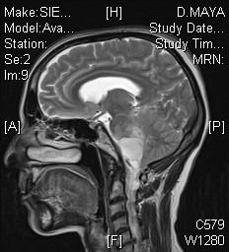
Diffuse Brainstem Glioma
T2W

Slide 49
BSG……
Type II : Focal intrinsic tumors ( cystic/solid )
Sharply demarcated from surrounding tissue on
MRI and are associated with less brainstem edema.
Majority of these lesions are low grade gliomas
(WHO I or II).
Contrast enhancement : variable

Slide 50
BSG……
Type III : Exophytic tumors that arise from the
subependymal glial tissue of the fourth
ventricle and mostly grow dorsally or laterally.
MRI characteristics similar to type II lesions,
and histologically, these lesions are usually
low-grade lesions (WHO I or II) like type II
lesions.

Slide 51
BSG……
Type IV lesions are cervicomedullary
brainstem gliomas.
Imaging, histology and behavior : similar to intramedullary spinal cord gliomas.
Majority are low-grade, non-infiltrative
tumors.

Slide 52
BSG….Clinical
Repeated vomiting with failure to thrive.
School-aged children : a decline in school
performance.
Cranial neuropathies can develop and produce subtle
changes.
A history of dysphonia or changes in voice pitch and
tone.
Frequent upper-respiratory infections

Slide 53
BSG…..Management
Biopsy : only for indeterminate lesions as no
therapeutic benefit is gained by sampling lesions that
behave and appear like diffuse gliomas.
Stereotactic biopsy: can provide diagnostic tissue.
Not without risk:
Damage to the cranial nerves and long tracts .
The HPE may not necessarily correlate with clinical
prognosis. ( Tissue heterogeneity )

Slide 54
Management
A patient with a clinical presentation and imaging
consistent with a diffuse glioma : NO BENEFIT from
surgery.
Corticosteroids/ RT may provide temporarily benefit.
A large phase III trial demonstrated no
benefit for the use of hyperfractionated radiation in
children newly diagnosed with diffuse brainstem
glioma .
Mandell LR, Int J Radiat Oncol Biol Phys 1999; 43: 959–964.

Slide 55
Management…Focal BSG
Location
Dorsal midbrain
(tectum mesencephali)
Ventral midbrain
Lateral midbrain
Ventrolateral pons
(cerebellopontine angle)
Dorsal pons and medulla
oblongata
Lower medulla oblongata
and cervicomedullary junction
Approach
Supracerebe llar
infratentorial
Pterional trans-Sylvian
Subtemporal transtentorial
Retromastoid re tros igmoid
Midline suboccipital
transventricular
(through the fourth ventricle)
Midline suboccipital
and C1 laminectomy

Slide 56
Management……..Postoperative Course
Postoperative treatment and monitoring : on the location
Patients who have had a CSF diversion procedure : monitor
for reemergence of signs and symptoms of hydrocephalus.
Tumors of the pons carry the worst prognosis because the
majority are diffuse gliomas. ( survival rates are low with a
1-year survival of 35–46% and 3- year survival of 11–17%.
Pediatr Neurosurg 1996; 24: 9–23.

Slide 57
Management……..Postoperative Course
The postoperative course of focal medullary neoplasms
depends on the tumor type.
Dorsal exophytic tumors treated with surgery have an excellent
prognosis with a 92% long-term survival some series.
Pediatr neurosurg 1994; 20: 2–10
Pollack et al. reported a long-term survival of 94% in
their series of 18 patients.
J Neurosurg 1993; 78: 859–863.

Slide 58
Management……..Postoperative Course
However, significant lower cranial nerve
dysfunction can occur and may
need prolonged postoperative
ventilation or a feeding gastrostomy
postoperatively.

Slide 59
Tectal plate gliomas
Unique subset of brainstem gliomas.
Presents with late onset obstructive
hydrocephalus that can be confused with
benign aqueductal stenosis.
Tectal gliomas are believed to be low-grade
astrocytic tumors that usually follow a benign
clinical course.
VP shunts or ETV for CSF diversion.

Slide 60
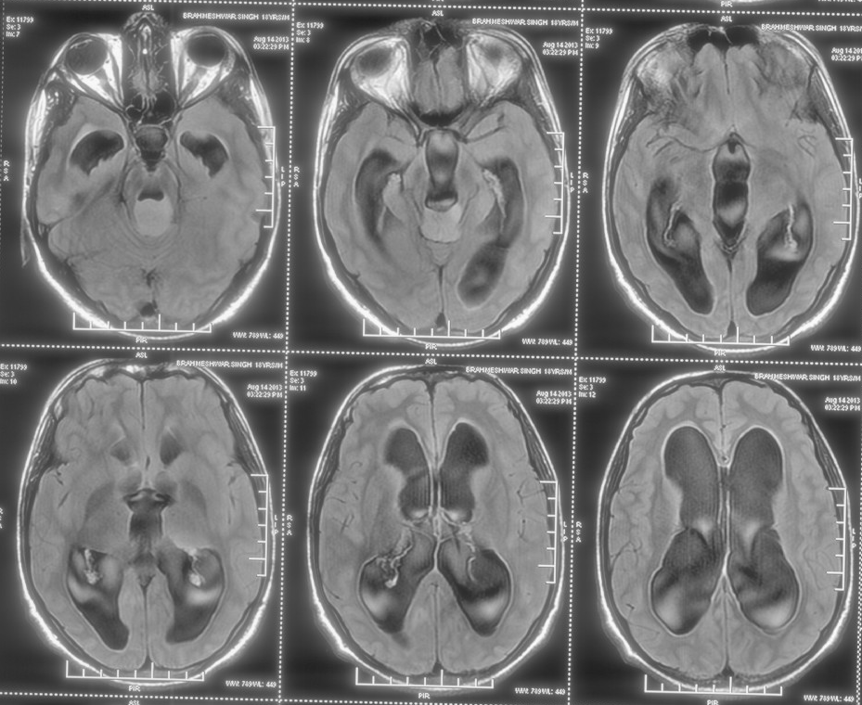
MRI

Slide 61
AIIMS Protocol
Radical Radiotherapy with
concurrent chemotherapy.
60 Gy/30#/ 6 wks.

Slide 62
Ependymoma
Ependymomas are glial tumors that arise from ependymal cells within the CNS.
WHO grade I : Myxopapillary ependymoma and
subependymoma;
WHO grade II : Ependymoma (with cellular,papillary and clear cell variants)
WHO grade III : Anaplastic ependymoma.
Who grade IV : Ependymoblastomas

Slide 63
Ependymoma
In children : 90% of ependymomas are intracranial, majority of these occuring in the posterior fossa usually arising from the roof of the fourth ventricle
In adults : 75% of ependymomas arise within the spinal canal, with a significant minority occurring intracranially in the supratentorial compartment.

Slide 64
Ependymoma …….. Imaging
  CT : Typically
  isodense with
  heterogenous
  enhancement
  Calcification :
  common ( can be
  seen in one half of
  cases)

Slide 65
Ependymoma…..MRI
  On MRI, heterogeneous secondary to necrosis, hemorrhage and calcification.
  Heterogenous contrast enhancement
  Plastic ependymomas.
  Extension to the cerebellopontine angle is characteristic of ependymomas
  Commonly found intraventricularly
  Calcification common ( appro.45% of cases )

Slide 66
Ependymoma…..
Staging: No conventional staging criteria.
Postoperative MRI is recommended within 48 hours of tumor resection to assess presence of residual tumor and to facilitate adjuvant treatment planning.

Slide 67
Ependymoma…..Surgery
Most significant factor associated with increased survival in almost every large series of pediatric ependymoma.
  Aggressive primary resection,
  Immediate second look surgery if a post-operative residual tumor is identified and
  Re-surgery at time of recurrence.

Slide 68
Ependymoma…Role of Radiotherapy
Post-operative radiation recommended for patients older than 3 years.
Stereotactic radiosurgery : therapeutic option in patients with residual, unresectable or recurrent tumor.

Slide 69
Ependymoma…Role of Chemotherapy
May be useful < 3 years : Delay cranial radiation.
Childhood intracranial ependymomas : in general
chemo-resistant
  over-expression of the multi-drug resistance-1 gene and the 06-
  methylguanine-DNA methyl transferase.
Children cancer group (CCG) 942: the only randomized
trial, which compared survival after radiation alone, and
survival after CT + RT did not show improved outcome
Med Pediatr Oncol 1996;27:8-14

Slide 70
AIIMS Protocol
Low Grade
CSF -VE
High grade
CSF + VE
Surgery
Surgery
Radiotherapy
56Gy / 28# / 5.5 wks
(50 Gy followed by a boost of 6 Gy)
Surgery followed by
CSI and 6 cycles chemotherapy.

Slide 71
Pilocytic astrocytoma
Pilocytic astrocytoma is the most common pediatric
central nervous system glial neoplasm
Exceptional benign biologic behavior : extremely high
survival rate 94% at 10 years
Most patients present in the first 2 decades
Surgical resection is the treatment of choice.

Slide 72
Pilocytic astrocytoma….MRI
Four predominant imaging patterns :
Mass with a nonenhancing cyst and an intensely enhancing
mural nodule (21%)
Mass with an enhancing cyst wall and an intensely enhancing
mural nodule (46%)
Necrotic mass with a central nonenhancing zone (16%), and
Predominantly solid mass with minimal to no cystlike
component (17%)

Slide 73
Pilocytic astrocytoma….
Surgical resection of cerebellar pilocytic
astrocytomas is considered the treatment of choice.
Radiation therapy is strictly avoided, given its risk of
causing significant morbidity in children younger
than 5 years of age.

Slide 74
Pilocytic astrocytoma….
Resection of the mural nodule, when present, is the
k Resection of the cyst wall : Controversial ??
since the surrounding cyst occurs as a simple reactive change in most cases.
NO STATISTICAL DIFFERENCE IN SURVIVAL
has been noted in patients who have undergone
resection of the cyst wall compared with those in
which the cyst is left alone.

Slide 75
Pilocytic astrocytoma…. Prognosis
EXCELLENT: 10-year survival rate : up to 94%
In contrast to the generally poor outcome (for patients with an infiltrating brainstem glioma (WHO grade II), those with Pilocytic astrocytoma has a much better prognosis, with stable neurologic status and long term survival.

Slide 76
Pilocytic astrocytoma….Recurrence
Can occur many years after surgery
Repeat surgery : Desired treatment
Radiotherapy can be avoided if complete
resection possible.
Residual / Unresectable recurrence : RT
preferably SRS.

Slide 77
Choroid Plexus Papilloma
CPP are benign neoplasms of the choroid plexus.
Lateral ventricles : most common location in children.
4-6% of the intracranial neoplasms in children younger
than 2 years.
12-13% of intracranial neoplasms in children younger
than 1 year.

Slide 78
Choroid Plexus Papilloma…..Clinical
Hydrocephalus and raised ICT
The tumor itself can cause mass effect
possibly because of derangement of reabsorption mechanisms or blockage at other
sites in the ventricular system.

Slide 79
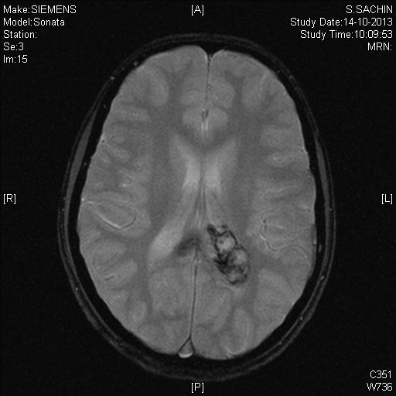
Choroid Plexus Papilloma

Slide 80
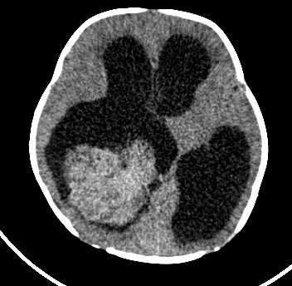
Choroid Plexus Papilloma…..Radiology
NCCT

Slide 81
Choroid Plexus Papilloma…..Radiology
On MRI : intermediate-to-strong intensity on both T1- and T2 - weighted images with dense enhancement.
Choroid plexus carcinoma appears more
heterogeneous than the papilloma and often
shows adjacent parenchymal invasion or
surrounding edema.

Slide 82
Choroid Plexus Papilloma…Management
Treatment of hydrocephalus must be considered both before and after any surgical procedures.
An acute increase in ICP : V P Shunt.
Hydrocephalus often resolves following removal of the mass.

Slide 83
Choroid Plexus Papilloma…Management
Total surgical resection is the goal.
Complete removal: generally curative in CPP.
Even in choroid plexus carcinoma, total resection leads to the best possible outcome.
Adjuvant CT and RT have been demonstrated to increase survival in the treatment of choroid plexus carcinoma, although gross total resection remains the primary treatment.

Slide 84
Dermoid cyst
Congenital ectodermal inclusion cysts.
Extremely rare, constituting fewer than 0.5% of
primary intracranial tumors .
Midline sellar, parasellar, or frontonasal regions :
most common sites.
Posterior fossa ( vermis or within the 4th
ventricle)

Slide 85
Dermoid cyst
Origin : inclusion of ectodermally
committed cells at the time of neural tube
closure (3rd–5th week of embryogenesis.)
Glandular secretion and epithelial desquamation.
Growth can lead to rupture of the cyst contents,
causing a chemical meningitis that may lead to
vasospasm, infarction, and even death.

Slide 86
Dermoid cyst
Well - defined, lobulated, “pearly” mass of
variable size.
Characteristically,the cyst contains thick,
disagreeable, foul-smelling, yellow material
due to the secretion of sebaceous glands and
desquamated epithelium.
The cysts may also contain hair and/or teeth

Slide 87
CONCLUSIONS
Pilocytic astrocytoma bears the best outcome.
Management of hydrocephalus still remains
controversial.
Though surgery and RT remains the
treatment of choice for medulloblastoma;
optimal cranispinal radiation dose remains
debatable.
Outcome for brainstem gliomas remains
dismal.

